Slide 1
Files and the Bash Shell CSCI 2200

Slide 2
Objectives
Review Unix Directories
Introduce Unix file commands
Become more efficient with the bash shell

Slide 3
Review of Unix Directories
There is no desktop like in Windows (no GUI)
Your general work area is the directory
You have to visualize the file structure to understand where you are and where you want to go
Tools for the journey:
pwd
ls
cd
mkdir
rmdir
rm
cp
mv
man

Slide 4
File/Directory Naming
Names can be up to 255 characters in length
Names are case sensitive
Allowed characters include:
Upper/lower case (A-Z, a-z)
Numbers (0-9)
Underscore (_)
Period (.)
Comma (,)

Slide 5
Two Types of Files
Plain text files
Human readable
Typically used for:
Documentation
Application settings
Logs
Binary files
Not human readable
Typically used for:
Executables
Libraries
Zip files

Slide 6
File Commands

Slide 7
Unix File Commands
touch – create a blank file
more/less – display a file one screen (or line) at a time
head/tail – display the first/last part of a file
cat - display contents of a file
echo – print text to the screen
chmod – change file permissions – change mode
rm – remove file
cp – copy file
mv – move file (also rename file)

Slide 8
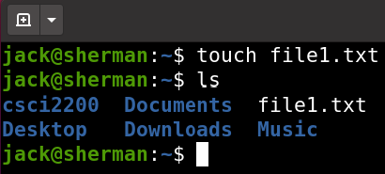
touch
Useful for when you need a file to exist:
Lock/done/flag files
Files for use in examples

Slide 9
touch
Useful for updating a file’s timestamp
-a flag to change the access time
-m flag to change modification time
-c flag to ensure a file is not created
For when you expect a file to exist
Shell scripting – you might want to error out of a script if the file does not exist, instead of just creating an empty file

Slide 10
touch
File extensions (.exe, .txt) typically do not matter in Unix
But they are still useful for visually identifying file usage

Slide 11

more or less
more [file name] – Allows you to scroll through the file one page at a time
less [file name] – Similar to more, but you can scroll up or down by pages or lines
Often, you don’t want to edit a file to see what’s in it
( -N tells less to display line numbers)

Slide 12
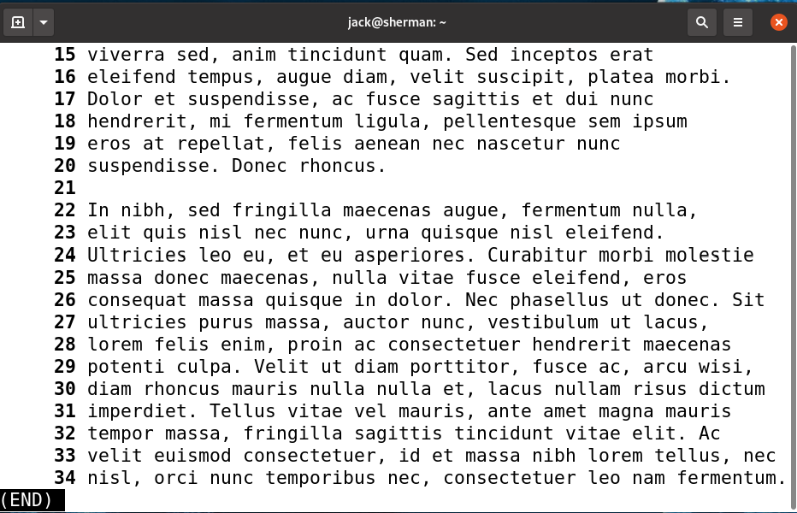
more or less
Less will display the file, one screen (or line) at a time
The space bar will advance the display a page at a time
Down arrow will advance a line at a time
You can search for a word by entering a slash and the word - /foo
n will advance to the next match, if there is one

Slide 13
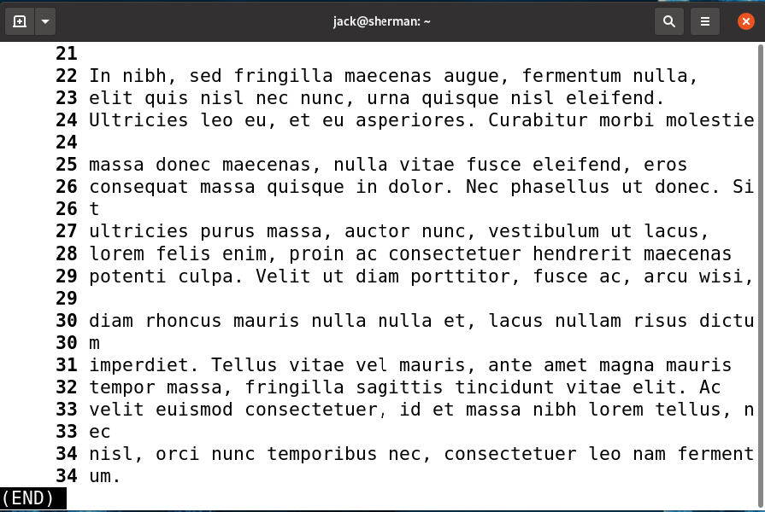
more or less
(END) indicates the end of the file
'q' to quit

Slide 14

head or tail
When you want to read a header or follow a log file, use head and tail respectively
The default number of lines for both is ten
For following a log file, use the –f flag of tail
As a process writes information to the log file, tail will display the new text on the screen automatically
head –[number of lines] [file name] – Print the first [number of lines] of the file
tail –[number of lines] [file name] – Print the last [number of lines] of the file

Slide 15
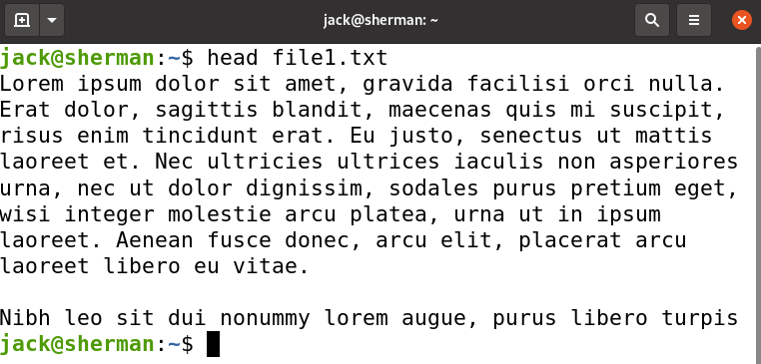
head or tail
Prints the first 10 lines of the file

Slide 16
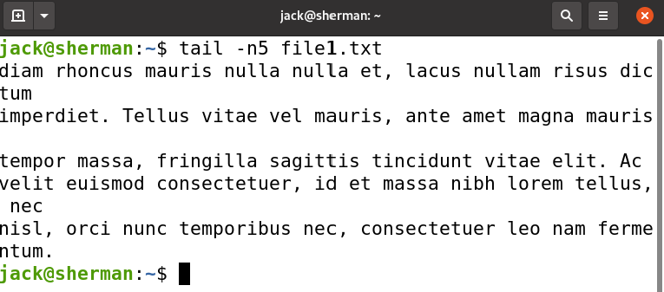
head or tail
Prints the last lines of a file
-n5 tells it to just print the last 5 lines of a file
tail is particularly useful for monitoring log files using the -f argument

Slide 17
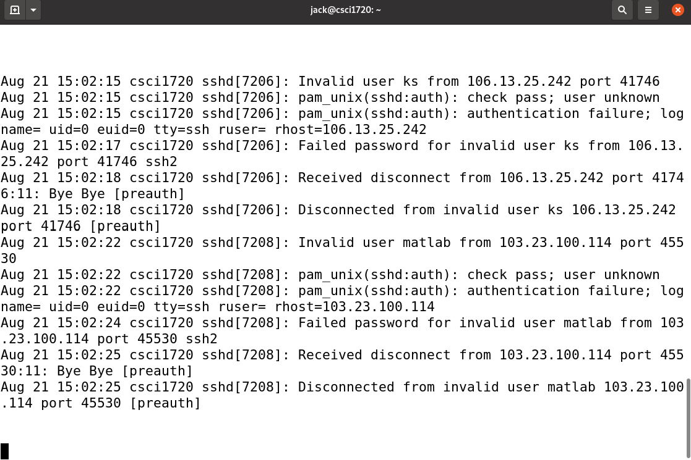
head or tail
tail -f prints changes to the file as they occur
Ctrl-c exits

Slide 18

cat
cat [file name] – Displays contents of the file
cat [file name 1] [file name 2] – Displays the contents of file 2 catenated to the end of the contents of file 1
It’s an abbreviation of concatenate, meaning to connect things together
While the 2nd usage above is what the program was designed to do, it is typically used in the 1st way to display a single file
Flags to use:
-n Precede each line of output with its line number
-b Like the –n flag but omit line numbers from blank lines

Slide 19
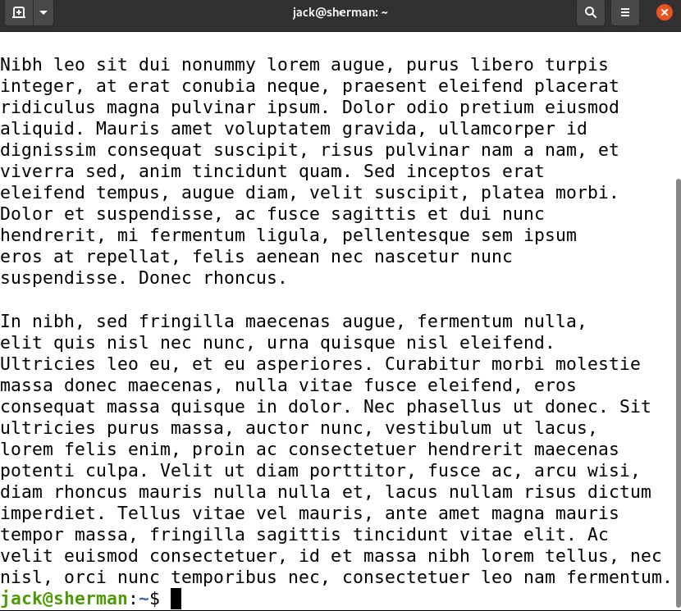
cat
Not much else to say
But I use cat a lot

Slide 20
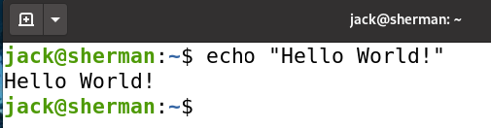
echo
Technically, echo is “printing” the text to the “standard output” or what we call “the terminal”
This is a very useful command when doing shell scripting and you need to write something to a log file

Slide 21
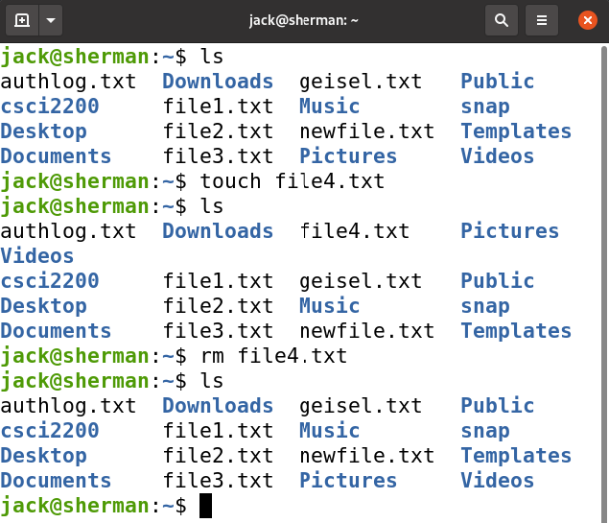
rm
Removes a file
rm -r - removes a directory (‘r’ stands for recursive)
rm -rf - suppresses “Are you sure?” prompts; Usually run as root
Just make sure you have everything entered correctly - once a file in L/Unix is gone, it’s gone forever!

Slide 22
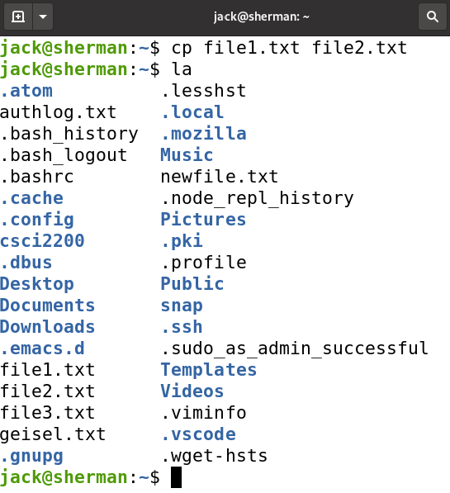
cp
Used to copy a file
Usually to another location, but not necessarily
cp [ [path/]source file] [ [path/]destination file]

Slide 23
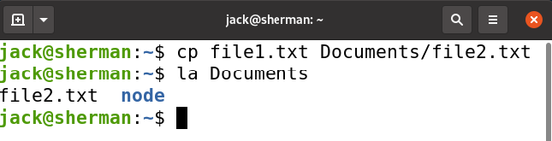
cp
Used to copy a file
Usually to another location, but not necessarily
Can be used to rename the file
cp [ [path/]source file] [ [path/]destination file]

Slide 24

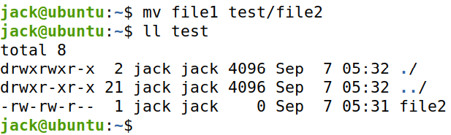
mv
Moves (or renames) a file
Usually to another location, but not necessarily
If not moving to a different directory, the file will be renamed
Can also be renamed when moving to a different directory
mv [file] [renamed file]
mv [ [path/]source file] [ [path/]destination file]

Slide 25
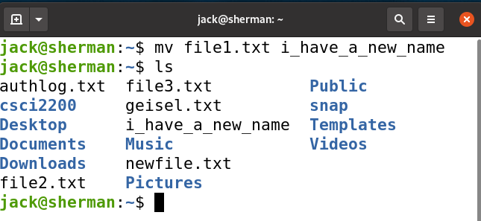
mv
Used to move (or rename) a file
mv [file] [renamed file]
mv [ [path/]source file] [ [path/]destination file]

Slide 26
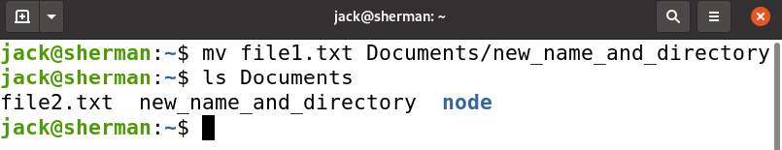
mv
Used to move (or rename) a file
mv [file] [renamed file]
mv [ [path/]source file] [ [path/]destination file]

Slide 27
Redirection

Slide 28
Input/Output Redirection
Let’s revisit that “standard output” term
Three I/O streams/connections:
Standard input – the keyboard
Standard output – the terminal window(screen)
Standard error – typically the terminal
Often referred to as stdin (0), stdout (1), and stderr (2)

Slide 29
Input/Output Redirection
Redirecting – changing the source or destination of the I/O streams
Input redirect: less sign ( < ) - (Here Document)
Output redirect:
greater than sign ( > )
Create a new or overwrite an existing file, sending the standard output to the file
Two greater than signs ( >> )
Create a new or append to an existing file
Pipe ( | )
Sends the output of one command as the input of another (more on that later)

Slide 30
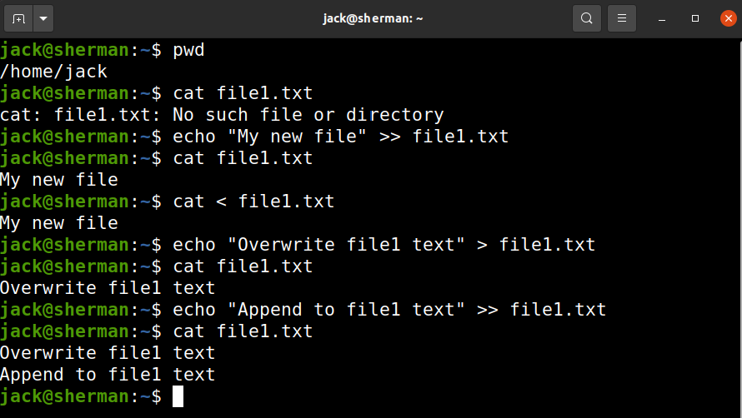
Redirection Examples

Slide 31
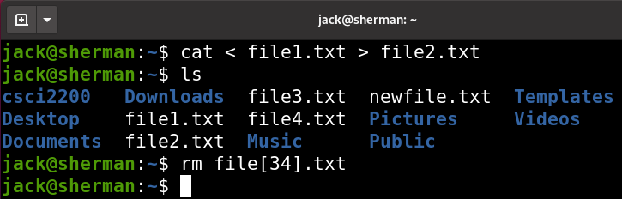

Redirection Examples
Note that the following do the same thing:
Also note, that redirection can be used with any command, not just the cat command

Slide 32

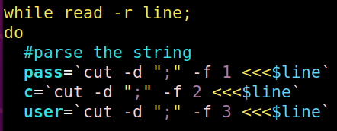
Redirection Examples
Another redirect - the ‘Here String’: <<<
Feeds a string (instead of a document) into a command
VERY useful for scripts:

Slide 33
Using Bash Efficiently
Shell Shortcuts
Reusing history
Aliasing
Special character expansion

Slide 34
Shell Shortcuts

Slide 35
Shell Shortcuts
The number one problem with using Unix:
It’s like you’re writing a book
You’re trying to write programs and administer systems, not become a typist!

Slide 36
Shell Shortcuts
Shortcuts
Tab completion
Up-down arrow: browse through command history
Ctrl-e: jump cursor to the end of the line
Ctrl-a: jump cursor to beginning of line
Ctrl-u: delete everything from cursor to beginning of line
Ctrl-k: delete everything from cursor to end of line
Ctrl-l: clear the screen

Slide 37
Shell Shortcuts
More Shortcuts:
http://www.aboutlinux.info/2005/08/bash-shell-shortcuts.html

Slide 38
Command History

Slide 39
Reusing History
Search your history by pressing Ctrl-r
Begin typing the command you want to recall
Press Ctrl-r again to cycle through other matches
If you find the entry you are looking for, press the enter key to execute it
Press the ESC key to put the command on the prompt without executing it
Press Ctrl-g to exit the search and return to an empty prompt

Slide 40
Reusing History
1. Ctrl-r changes the prompt to “(reverse-i-search)”
3. The shell searches through the command history and displays the last-run command that matches what you’ve entered
2. Begin typing in the command name

Slide 41
Reusing History
Another option is to run the history command
All the past commands in the command history will be displayed
To re-run one of the commands use an exclamation mark (!) and the line number

Slide 42
Reusing History
Another option is to run the history command
All the past commands in the command history will be displayed
To re-run one of the commands use an exclamation mark (!) and the line number

Slide 43
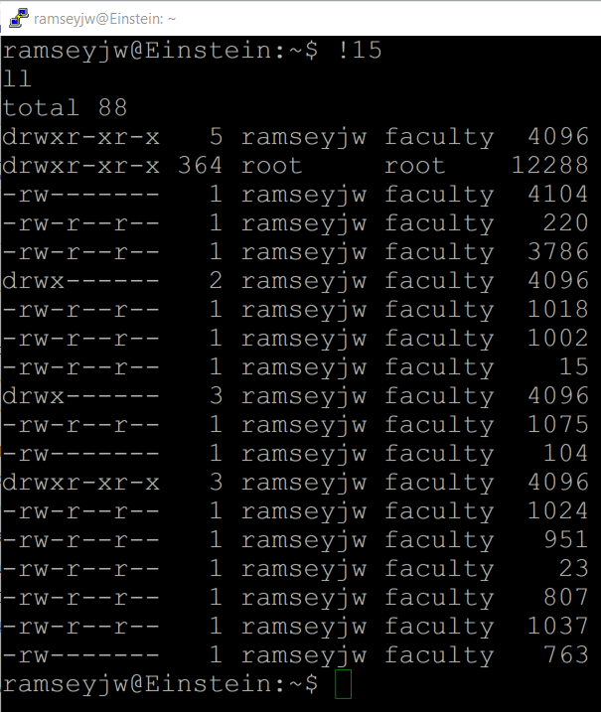
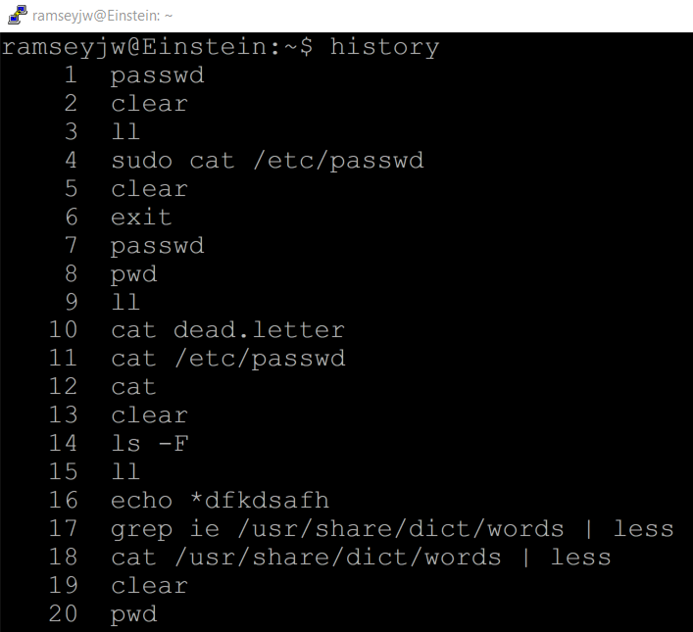
Reusing History
1. Enter history
2. Enter !15

Slide 44
Tab Completion
One nice feature with the bash shell (and the DOS CLI & PowerShell) is Tab Completion
When entering a command we can enter the first few letters of the operand and press the Tab key
If the first few letters match a file in the present working directory, the shell will complete it for us

Slide 45
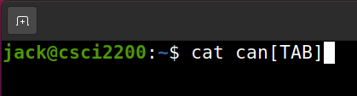

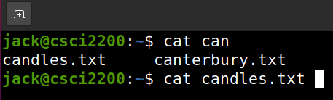
Tab Completion
This is super-useful when you are working with long filenames, like ubuntu-20.04.2.0-desktop-amd64.iso
If there is more than one match, the shell will display them all and re-prompt for the next letter of the one you want

Slide 46
Shell Expansion

Slide 47
Shell Expansion
Three types
File name expansion
Bracket expansion
Brace expansion
Command substitution
We will review these again (more) when looking at regular expressions

Slide 48
File Name Expansion
* / ?
Bash scans for these characters, if found, it is regarded as a pattern
We will revisit this concept with regular expressions
* -- matches any string
? -- matches a single character

Slide 49
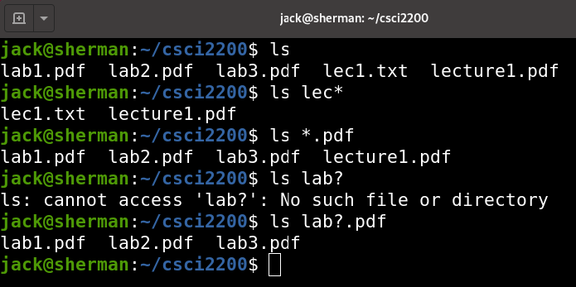
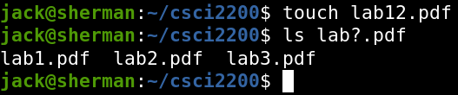
File Name Expansion

Slide 50
Bracket Expansion
[ ] – Brackets: match any character inside the brackets
Use a dash to indicate a range of characters
Use a comma to separate ranges
[! ]or [^ ]– match characters not inside the brackets
NO SPACES!

Slide 51
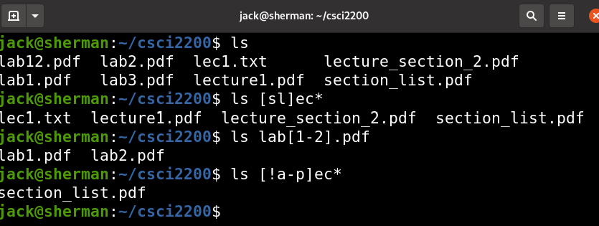
Bracket Expansion

Slide 52
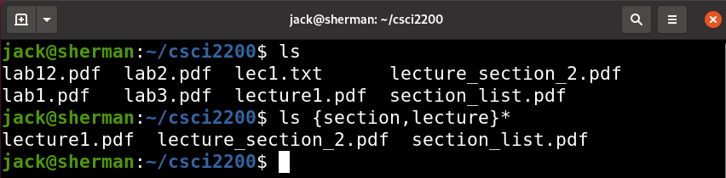
Brace Expansion
{ } – Braces match any phrase inside the braces, separated by a comma
Must have at least two options (NO SPACES!)

Slide 53
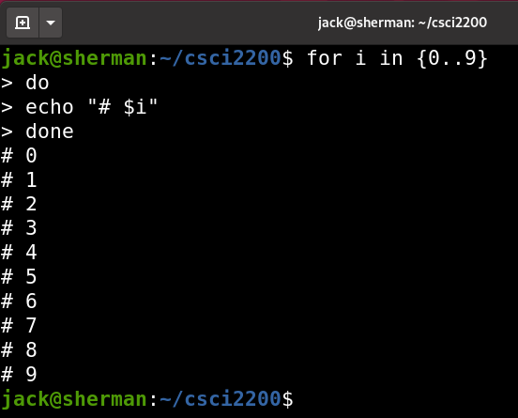
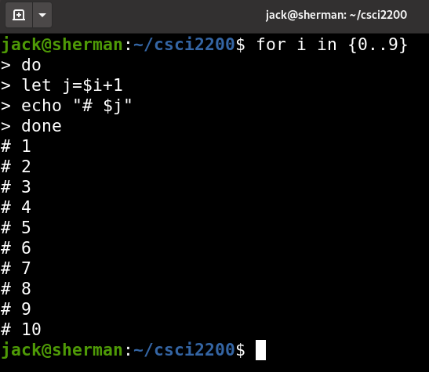
Brace Expansion – More Fun

Slide 54
More Examples
Input | Matched | Not Matched
lec* | lecture1.pdf lec.avi | AlecBaldwin
l*ure* | lecture2.pdf lectures | sure.txt
*.tex | lecture1.tex Presentation.tex | tex
lecture?.pdf | lecture1.pdf lecture2.pdf | lecture22.pdf
ca? | cat can cap | ca cake

Slide 55
More Examples
Input | Matched | Not Matched
[sl]ec* | lecture section | vector.tex
day[1-4].pdf | day1.pdf day2.pdf | day5.pdf
[A-Z,a-z][0-9].mp3 | A9.mp3 z4.mp3 | Bz2.mp3 9a.mp3
[^A-P]ec* | Section.pdf | Lecture.pdf
[^A-Za-z]* | 9Days.avi .bash_profile | Vacation.jpg
{Hello, Goodbye} World | Hello World Goodbye World | Hello beautiful World Goodbye cruel World

Slide 56
More Examples
Input | Matched | Not Matched
*i[a-z]e* | gift_ideas profile.doc | DriVer.exe
[bf][ao][ro].mp? | bar.mp3 foo.mpg | foo.mpeg
*[ab]*.??? | lab1.pdf lec1.txt | 9a.mpeg

Slide 57
Command Substitution

Slide 58
Command Substitution
Replace the command with the output of that command
Two ways to qualify the command:
$(command)
`command`
These are backticks (same key as the tilde), not single quotes

Slide 59
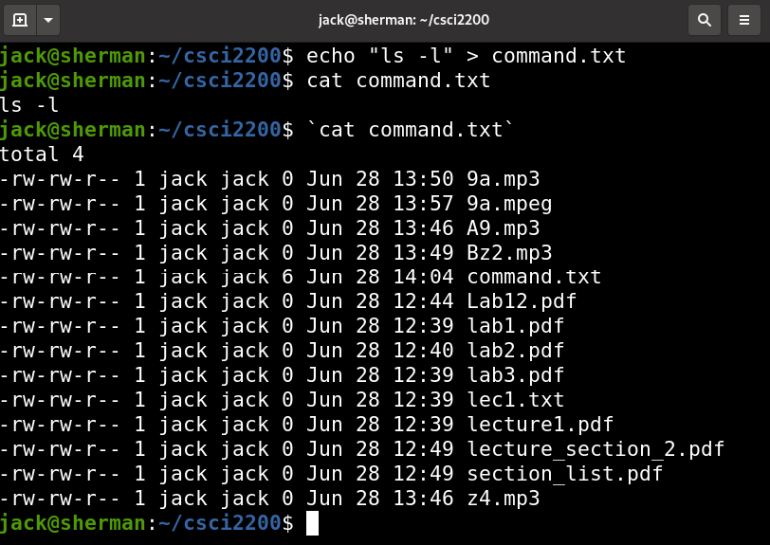
Command Substitution

Slide 60
Conclusion
These are some of the essential commands
Production work with Unix/Linux typically doesn’t involve a Graphic User Interface
You must grow comfortable working from a Command Line Interface
This includes learning all the shortcuts you can to ease the pain

Slide 61


